Slide 1


Unlocking Happiness
Data Insights On What Really Matters In life
Group 2
Eduardo Gonzalez
Jenny Jaurequi
Mariem Diaz
Tai Reagan
Jorge Reyes

Slide 2
Data Source:
Remote Work & Mental Health:
This dataset contains information into key areas like work location (remote, hybrid,and onsite), stress levels, access to mental health, job satisfaction just to name a few and was collected from https://www.kaggle.com/datasets/waqi786/remote-work-and-mental-health
Esteban Ortiz-Ospina and Max Roser (2017) - “Happiness and Life Satisfaction” Published online at OurWorldinData.org. Retrieved from: 'https://ourworldindata.org/happiness-and-life-satisfaction' [Online Resource]
Warning:
This analysis is based on synthesized data, created to model potential trends and insights into factors that impact life satisfaction and well-being. Please note that this data does not represent real-world information and was generated solely for the purpose of illustrative analysis.

Slide 3
Where My Happy People At?

Slide 4


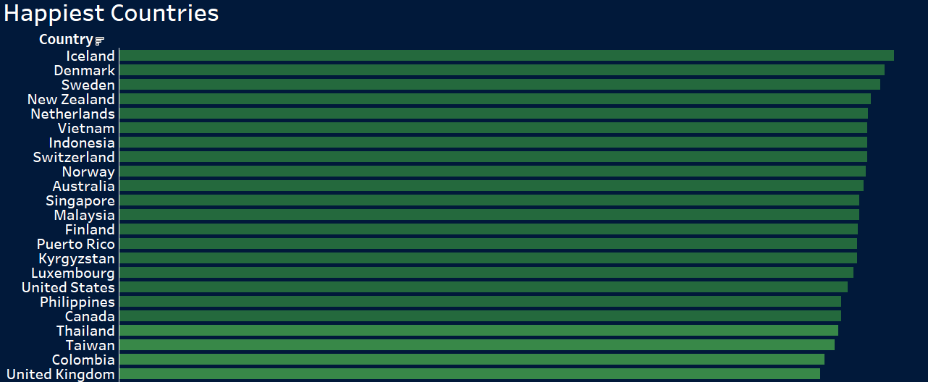
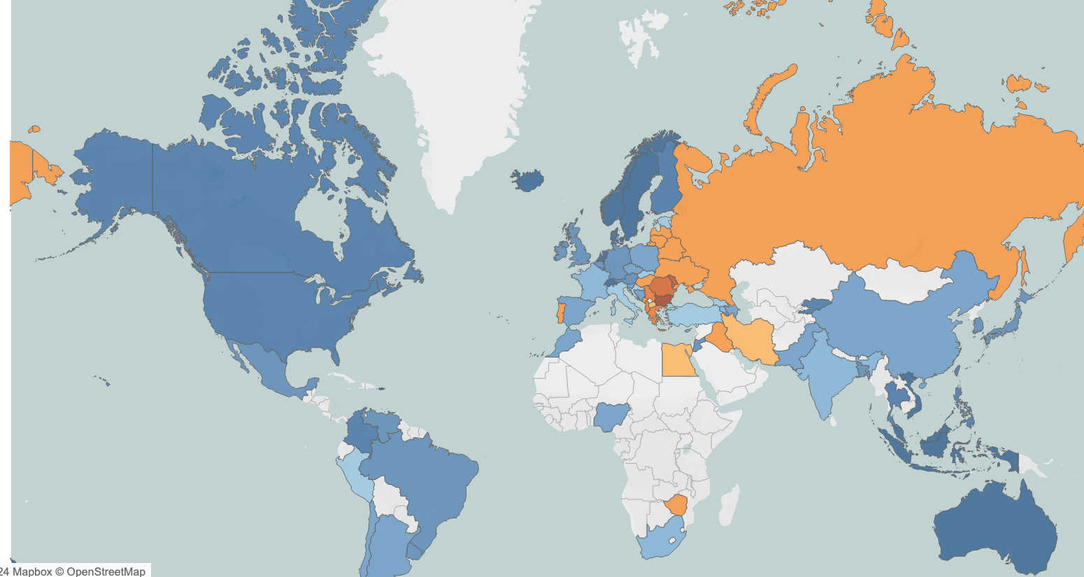
Countries With The
Highest Happiness Ratings

Slide 5
Research Questions?
How does working conditions impact employee well-being and life satisfaction in countries with higher happiness ratings?
Does work location (remote, hybrid, on-site), serve as a positive driving force towards increasing people’s well being and life satisfaction?
Can machine learning help us understand which variables have the highest impact to a greater quality of life?

Slide 6
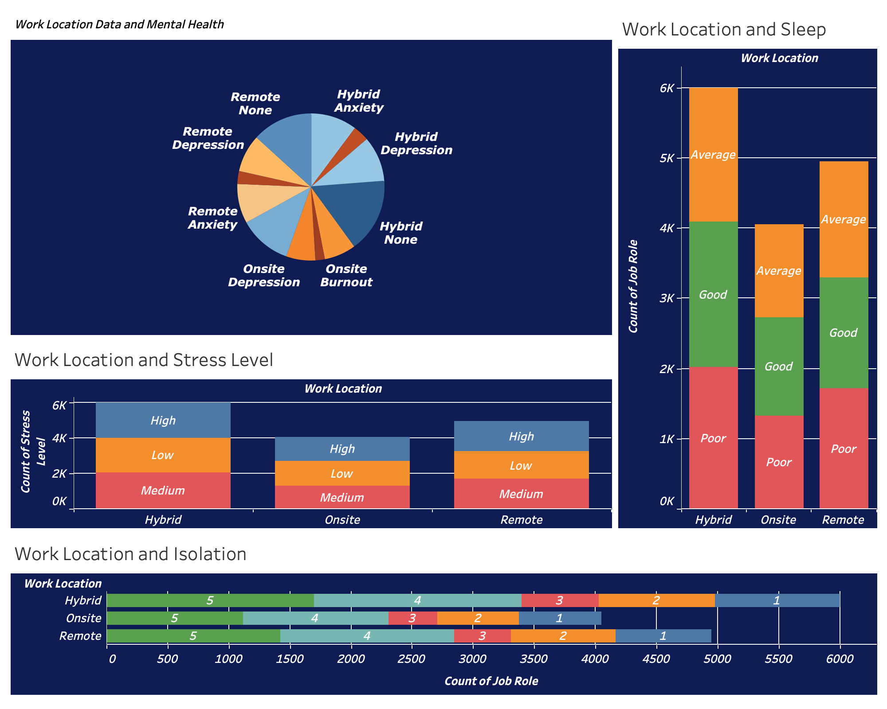
Looking At The Big Picture
Jorge Slide
Add Graph image here
Bullet Point
Bullet Point

Slide 7
Predicting
Sleep Quality

Slide 8
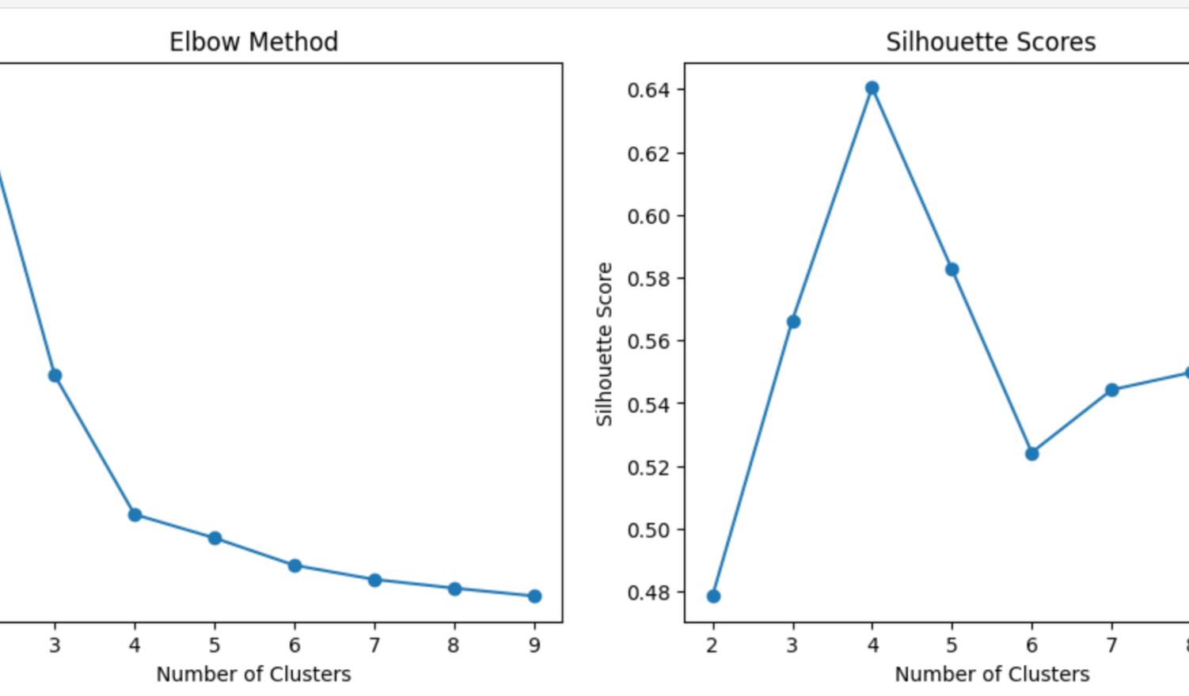
Unsupervised Learning Model
- Applied KMeans clustering to analyze happiness-related features.
- Determined optimal clusters size using the elbow method and silhouette scores.
- Reduced data to 2 components using PCA for visualization.
- Identified clusters based on factors like work-life balance, stress, and sleep quality.

Slide 9

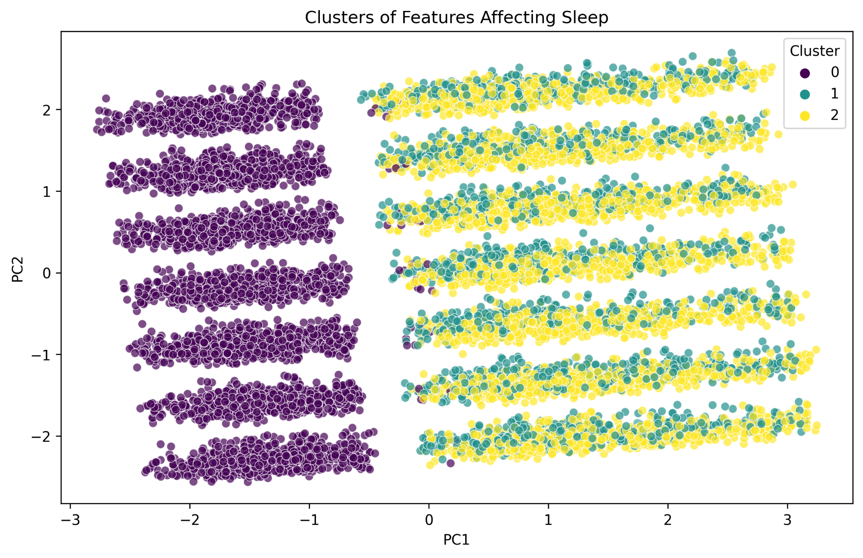
Work and Good Sleep
- Model Overview: Drops 'Sleep_Quality' to explore feature interactions.
- Clustering: Three clusters formed, with one distinct and the other two closely related.
- Insight: Clusters likely represent different work experiences, which may indirectly influence sleep quality.

Slide 10

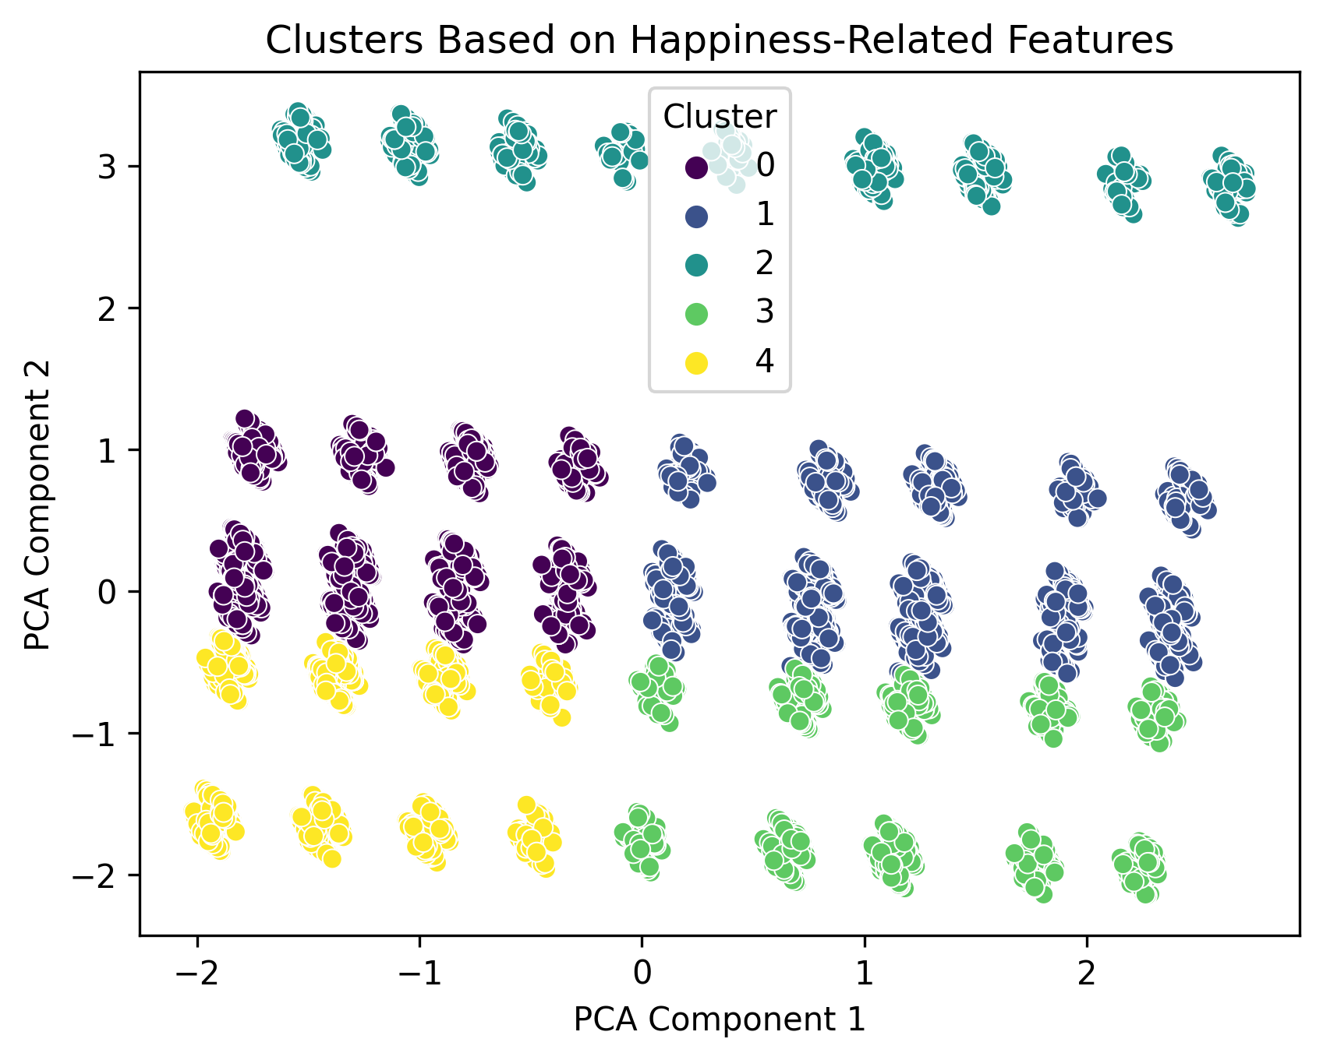
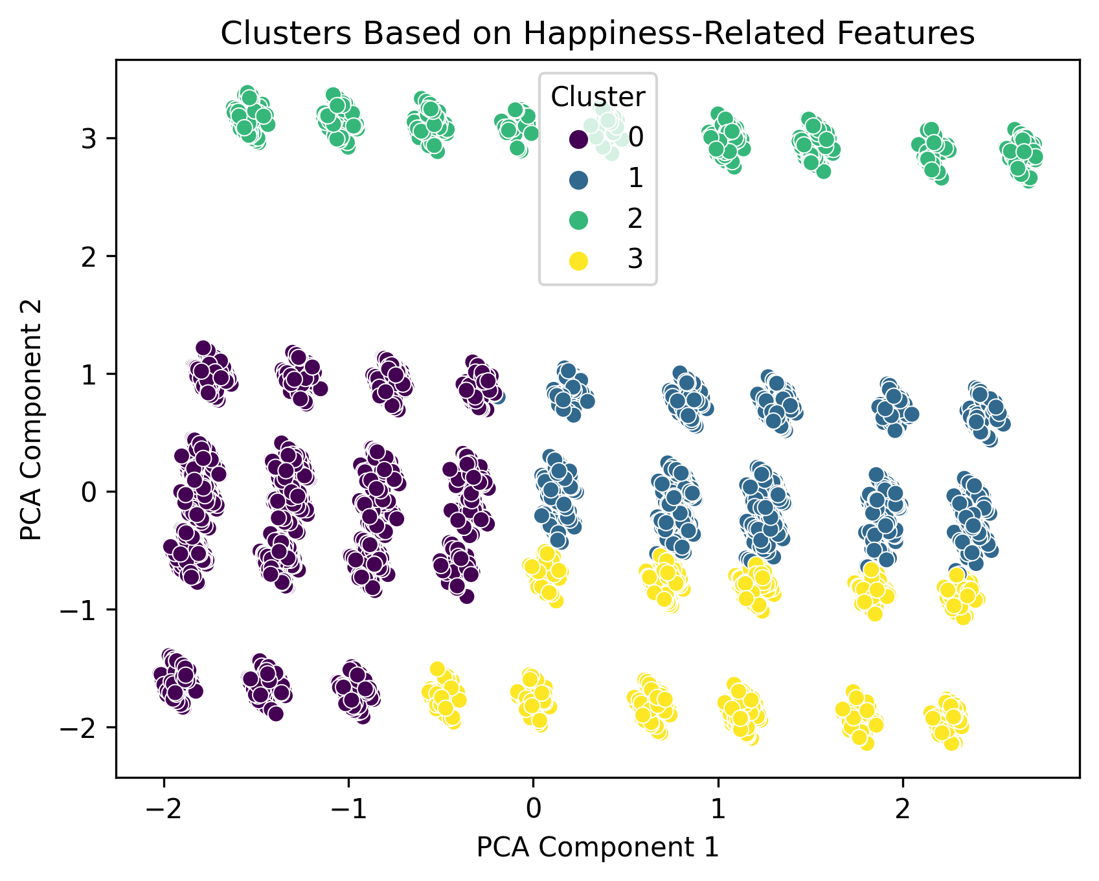
Optimizing the Model
- Direct Inclusion of Sleep Quality: Examines Sleep Quality as a primary factor.
- Distinct Sleep-Based Clusters: Clusters reveal unique sleep-related characteristics.
- Enhanced Insight into Well-being: Shows connections between sleep, stress, and work-life balance.
Well-being is holistic, 1 feature alone cannot affect all the others and vice versa.

Slide 11
Predicting
Stress Level

Slide 12
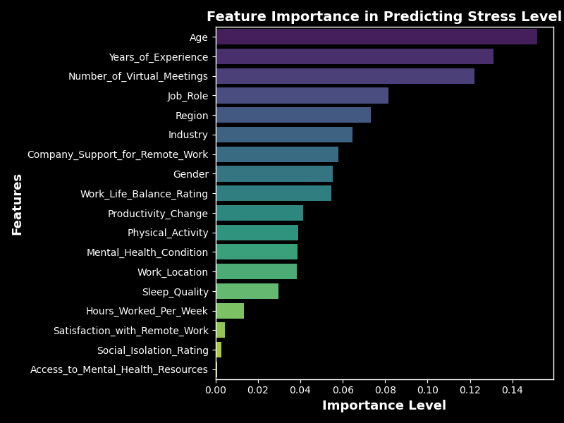

Decision Tree Model
The Decision Tree model achieves high overall accuracy of 94%, with consistently high precision, recall and F1-scores across all classes.
Age," "Years of Experience," and "Number of Virtual Meetings" are the top features influencing stress level predictions
Decision Tree Classification Report

Slide 13
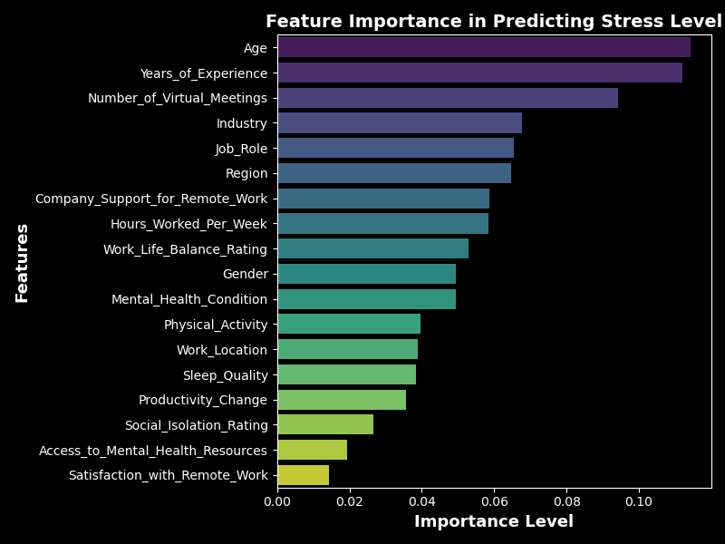

Random Forest Model
The Random Forest model achieves a high accuracy of 97.6% with a significantly lower precision, recall and f1-score.
Age, years of experience, and number of virtual meetings are key predictors in predicting stress levels.
Random Forest Classification Report

Slide 14
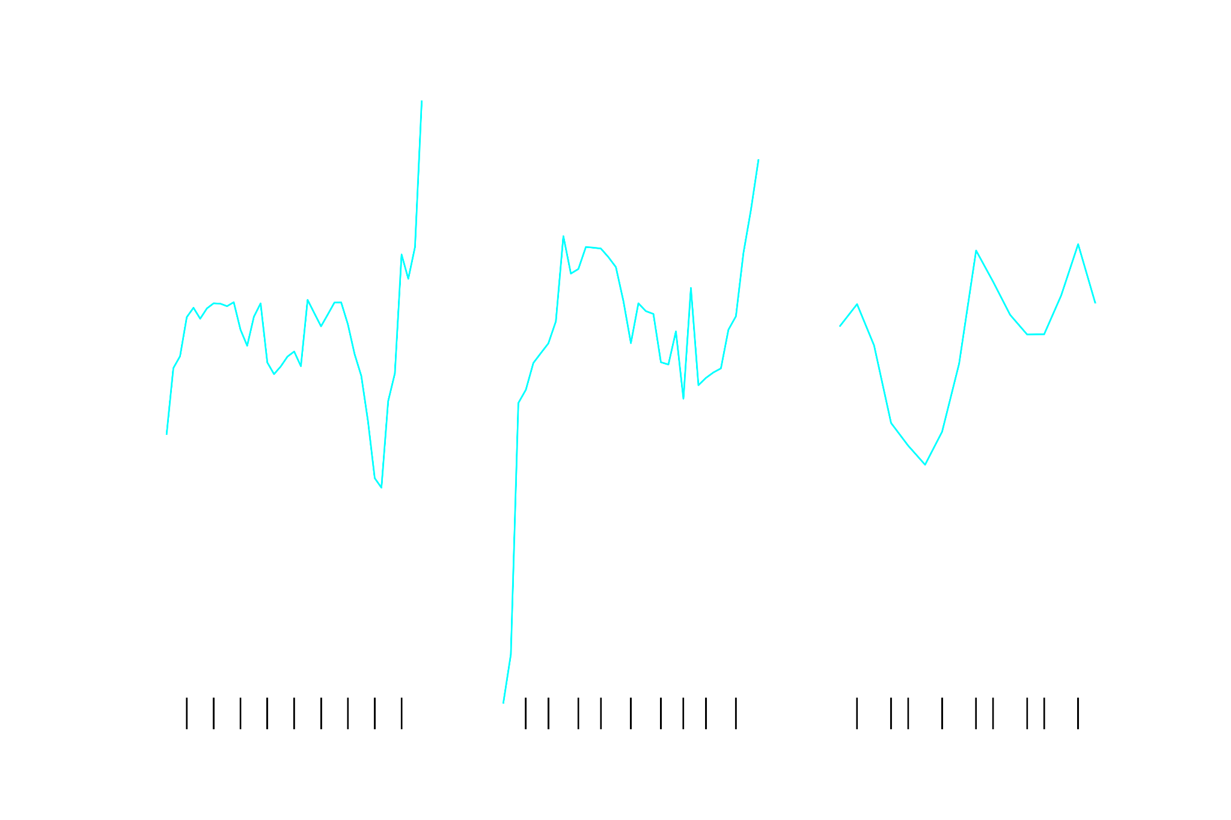

Slide 15
Effects of Isolation

Slide 16
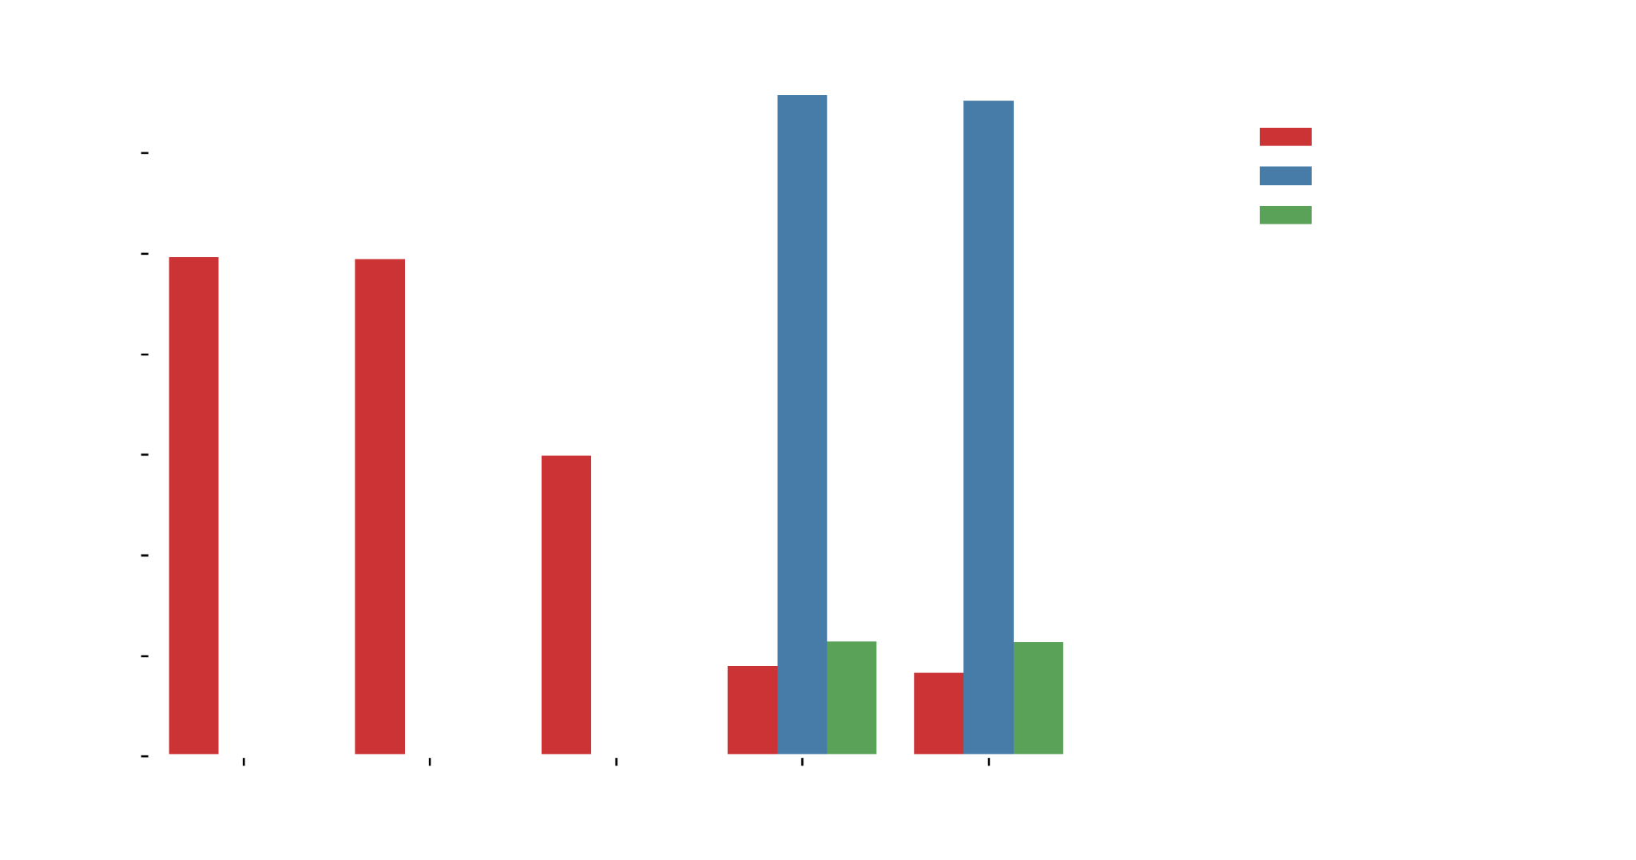
Isolation and Remote Work

Slide 17
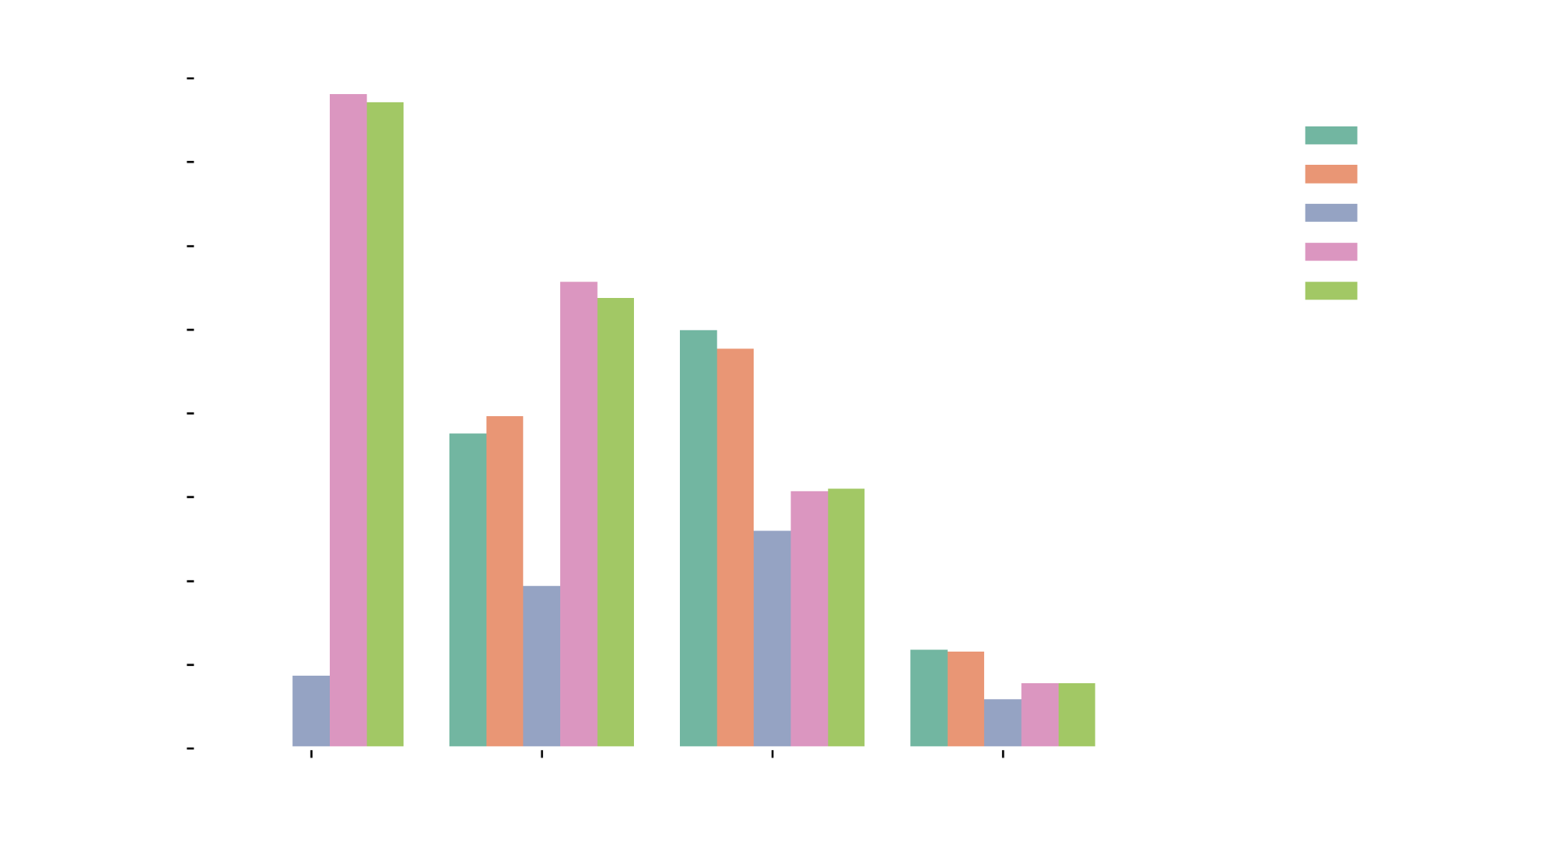
Connection to Hours Worked

Slide 18
Trends in Mental Health & Remote Work

Slide 19
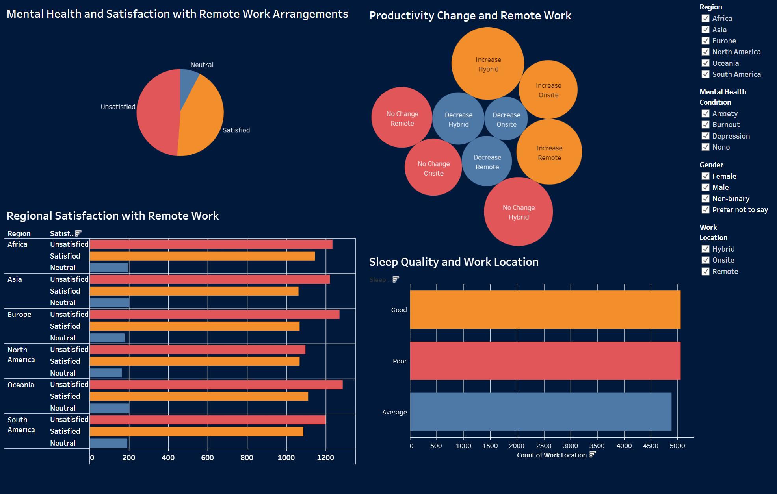
Dashboard link

Slide 20
Recommendations
&
Future Work
Address Regional Time Zone Challenges:
Provide more resources and training for asynchronous communication to improve satisfaction in regions with significant time zone differences from employers.
Collect Additional Demographic Data:
Include variables such as working hours, housing arrangements, and household responsibilities to better understand influences on satisfaction and productivity among different groups.
Explore Interactions Between Physical Activity, Sleep Quality, and Stress:
Conduct a deeper analysis into how lifestyle factors like physical activity and sleep quality interact with stress levels.
Acquire Real-World Data:
Explore methods to gather real-world data instead of relying on simulated data.

Slide 21
Thank You!

